Slide 1
Disciplined Agile Delivery
Introduction – Choosing the right Lifecycle
Central Bank of Ireland - RESTRICTED

Slide 2
Key Points in this Chapter
Some teams within your organization will still follow a traditional life cycle—DAD explicitly recognizes this but does not provide support for this shrinking category of work.
DAD provides the scaffolding required for choosing between, and then evolving, six solution delivery life cycles (SDLCs) based on either agile or lean strategies.
Project-based life cycles, even agile and lean ones, go through phases.
Every life cycle has its advantages and disadvantages; each team needs to pick the one that best reflects their context.
Common, lightweight, risk-based milestones enable consistent governance; you don't need to force the same process on all of your teams.
A team will start with a given life cycle and often evolve away from it as they continuously improve their WoW.
© Ambler, Scott. Choose your WoW, Project Management Institute.

Slide 3
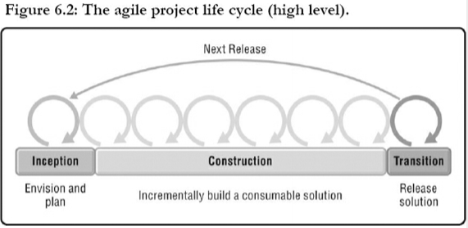
The Project Mindset Leads to Agile Phases
Many organizations choose to fund solution delivery in terms of projects. These projects may be date driven and have a defined start and end date, they may be scope driven in that they must deliver specific functionality or a specific set of outcomes, or they may be cost driven in that they must come in on or under a desired budget. Some projects have a combination of these constraints, but the more constraints you put on a delivery team, the greater the risk of project failure. Figure 6.2 depicts a high-level view of the project delivery life cycle, and as you see, it has three phases:
Inception. Inception is sometimes called “sprint 0,” “iteration 0,” startup, or initiation. The basic idea is that the team does just enough work to get organized and going in the right direction. The team will initially form itself, and invest some time in initial requirements and architecture exploration, initial planning, aligning itself with the rest of the organization, and of course securing funding for the rest of the project. This phase should be kept as simple and as short as possible while coming to an agreement on how the team believes it will accomplish the outcomes being asked of it by their stakeholders. The average agile/lean team spends 11 work days, so a bit more than two weeks, in Inception activities [SoftDev18].
© Ambler, Scott. Choose your WoW, Project Management Institute.

Slide 4
The Project Mindset Leads to Agile Phases (contd)
Construction. The aim of Construction is to produce a consumable solution with sufficient functionality, what's known as a minimal marketable release (MMR), to be of value to stakeholders. The team will work closely with stakeholders to understand their needs, to build a quality solution for them, to get feedback from them on a regular basis, and then act on that feedback. The implication is that the team will be performing analysis, design, programming, testing, and management activities potentially every single day. More on this later.
Transition. Transition is sometimes referred to as a “release sprint” or a “deployment sprint,” and if the team is struggling with quality, a “hardening sprint.” The aim of Transition is to successfully release your solution into production. This includes determining whether you are ready to deploy the solution and then actually deploying it. The average agile/lean team spends six work days on Transition activities, but when you exclude the teams that have fully automated testing and deployment (which we wouldn't do), it's an average of 8.5 days [SoftDev18]. Furthermore, 26 % of teams have fully automated regression testing and deployment, and 63 % perform Transition in one day or less.
© Ambler, Scott. Choose your WoW, Project Management Institute.

Slide 5
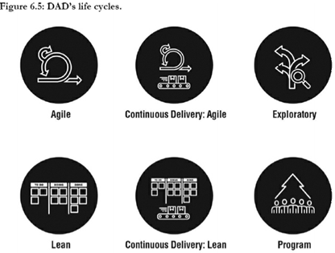
DAD’s Life cycles
DAD supports several life cycles for teams to choose from. These life cycles, described in detail below and summarized in Figure 6.5, are:
Agile. Based on the Scrum construction life cycle, teams following this project life cycle will produce consumable solutions via short iterations (also known as sprints or timeboxes).
Continuous Delivery: Agile. Teams following this agile-based life cycle will work in very short iterations, typically one week or less, where at the end of each iteration their solution is released into production.
Lean. Based on Kanban, teams following this project life cycle will visualize their work, reduce work in process (WIP) to streamline their workflow, and pull work into the team one item at a time.
Continuous Delivery: Lean. Teams following this lean-based life cycle will release their work into production whenever possible, typically several times a day.
Exploratory. Teams following this life cycle, based on Lean Startup [Ries] and design thinking in general, will explore a business idea by developing one or more minimal viable products (MVPs), which they run as experiments to determine what potential customers actually want. This life cycle is often applied when a team faces a “wicked problem” [W] in their domain.
Program. A program is effectively a large team that is organized into a team of teams (not included for CBI)
*Program – not included here for CBI
© Ambler, Scott. Choose your WoW, Project Management Institute.

Slide 6

Agile Life cycle
DAD's agile life cycle, shown in Figure 6.6, is based largely upon the Scrum life cycle with proven governance concepts adopted from the Unified Process (UP) to make it enterprise ready [Kruchten].
This life cycle is often adopted by project teams focused on developing a single release of a solution, although sometimes a team will stay together and follow it again for the next release (and the next release after that, and so on).
In many ways, this life cycle depicts how a Scrum-based project life cycle works in an enterprise-class setting, we've worked with several teams that like to think of this as Scrum++, without being constrained by the Scrum community's cultural imperative to gloss over the activities of solution delivery that they find inconvenient.
© Ambler, Scott. Choose your WoW, Project Management Institute.

Slide 7
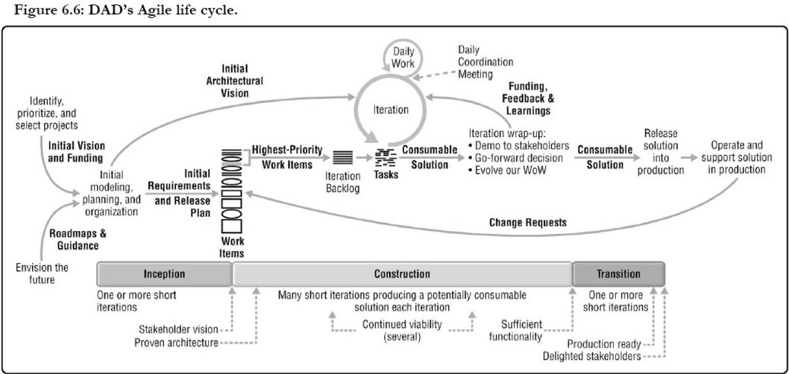
Agile Life cycle
© Ambler, Scott. Choose your WoW, Project Management Institute.

Slide 8
Agile Life Cycle – Critical Aspects
There are several critical aspects to this life cycle:
The Inception phase. Team's focus is to do just enough work to get organized and going in the right direction
Construction is organized into short iterations in which the delivery team produces a new, potentially consumable version of their solution.
Teams address work items in small batches. Work items are typically prioritized by the product owner, primarily by business value although risk, due dates, and severity (in the case of change requests) may also be taken into account.
Critical ceremonies have a defined cadence. Also like Scrum, this life cycle schedules several agile ceremonies on specific cadences (e.g. planning, demo, retrospective, daily standup). This does inject a fair bit of process overhead with ceremonies. This is a problem that the Lean life cycle addresses.
The Transition phase. Ensure that the solution is ready to be deployed and, if so, to deploy it. This “phase” can be automated away.
© Ambler, Scott. Choose your WoW, Project Management Institute.
Notes:
The Inception phase. As we described earlier, the team's focus is to do just enough work to get organized and going in the right direction. DAD aims to streamline the entire life cycle from beginning to end, including the initiation activities addressed by Inception. Inception ends when we have an agreed-upon vision regarding the expected outcomes for the team and how we're going to achieve them.
Construction is organized into short iterations. An iteration is a short period of time, typically two weeks or less, in which the delivery team produces a new, potentially consumable version of their solution. Of course, for a new product or solution you may not have something truly consumable until after having completed several iterations. This phase ends when we have sufficient functionality, also known as a minimal marketable release (MMR).
Teams address work items in small batches. Working in small batches is a fundamental of Scrum, and because this life cycle is based on Scrum, it's an important aspect of it. DAD teams, regardless of life cycle, are likely to work on a range of things: implementing new functionality, providing stakeholders with positive outcomes, running experiments, addressing end-user change requests coming in from usage of the current solution running in production, paying down technical debt, taking training, and many more. Work items are typically prioritized by the product owner, primarily by business value although risk, due dates, and severity (in the case of change requests) may also be taken into account. The Address Changing Stakeholder Needs process goal (Chapter 16) provides a range of options for managing work items. In each iteration, the team pulls a small batch of work off of the work item list that they believe they can achieve during that iteration.
Critical ceremonies have a defined cadence. Also like Scrum, this life cycle schedules several agile ceremonies on specific cadences. At the beginning of each iteration, the team performs detailed planning for the iteration, and at the end of the iteration, we hold a demonstration. We hold a retrospective to evolve our WoW, and we make a go-forward decision. We also hold a daily coordination meeting. The point is that by prescribing when to hold these important work sessions, we take some of the guess work out of the process. The downside is that Scrum injects a fair bit of process overhead with ceremonies. This is a problem that the Lean life cycle addresses.
The Transition phase. The aim of the Transition phase is to ensure that the solution is ready to be deployed and, if so, to deploy it. This “phase” can be automated away (which is exactly what happens when evolving toward the two continuous delivery life cycles).
Explicit milestones. This life cycle supports the full range of straightforward, risk-based milestones, as you see depicted along the bottom of the life cycle. The milestones enable leadership to govern effectively, more on this later. By “lightweight” we mean that milestones do not need to be a formal bureaucratic review of artifacts. Ideally, they are merely placeholders for discussions regarding the status and health of the initiative. See the Govern Delivery Team goal in Chapter 27 for a more detailed discussion of how to keep milestones light.
Enterprise guidance and roadmaps are explicitly shown. On the left-hand side of the life cycle, you see that important flows come into the team from outside of the delivery life cycle. That's because solution delivery is just part of your organization's overall DevOps strategy, which in turn is part of your overall IT strategy. For example, the initial vision and funding for your endeavor may be coming from a product management group, and the roadmaps and guidance from other areas such as enterprise architecture, data management, and security (to name a few). Remember, DAD teams work in an enterprise-aware manner, and one aspect of doing so is to adopt and follow appropriate guidance.
Operations and support are depicted. If your team is working on the new release of an existing solution then you are likely to receive change requests from existing end users, typically coming to you via your operations and support efforts. For teams working in a DevOps environment, it may be that you're responsible for running and supporting your solution in production.
Ambler, Scott. Choose your WoW, Project Management Institute.

Slide 9
Agile Life Cycle – Critical Aspects (contd.)
Explicit milestones. This life cycle supports the full range of straightforward, risk-based milestones enabling leadership to govern effectively. Milestones do not need to be a formal bureaucratic review of artefacts.
Enterprise guidance and roadmaps are explicitly shown. Important flows come into the team from outside of the delivery life cycle because solution delivery is just part of your organization's overall IT strategy.
Operations and support are depicted. If your team is working on the new release of an existing solution then you are likely to receive change requests from existing end users, typically coming to you via your operations and support efforts.
© Ambler, Scott. Choose your WoW, Project Management Institute.
Notes:
Explicit milestones. This life cycle supports the full range of straightforward, risk-based milestones, as you see depicted along the bottom of the life cycle. The milestones enable leadership to govern effectively, more on this later. By “lightweight” we mean that milestones do not need to be a formal bureaucratic review of artifacts. Ideally, they are merely placeholders for discussions regarding the status and health of the initiative. See the Govern Delivery Team goal in Chapter 27 for a more detailed discussion of how to keep milestones light.
Enterprise guidance and roadmaps are explicitly shown. On the left-hand side of the life cycle, you see that important flows come into the team from outside of the delivery life cycle. That's because solution delivery is just part of your organization's overall DevOps strategy, which in turn is part of your overall IT strategy. For example, the initial vision and funding for your endeavor may be coming from a product management group, and the roadmaps and guidance from other areas such as enterprise architecture, data management, and security (to name a few). Remember, DAD teams work in an enterprise-aware manner, and one aspect of doing so is to adopt and follow appropriate guidance.
Operations and support are depicted. If your team is working on the new release of an existing solution then you are likely to receive change requests from existing end users, typically coming to you via your operations and support efforts. For teams working in a DevOps environment, it may be that you're responsible for running and supporting your solution in production.
Ambler, Scott. Choose your WoW, Project Management Institute.

Slide 10
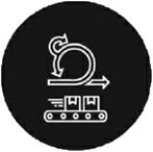
Continuous Delivery: Agile life cycle
DAD's Continuous Delivery: Agile life cycle, shown in Figure 6.7, is a natural progression from the Agile life cycle of Figure 6.6.
Teams typically evolve to this life cycle from the Agile life cycle, often adopting iteration lengths of one week or less.
The key difference between this and the Agile life cycle is that the Continuous Delivery: Agile life cycle results in a release of new functionality at the end of each iteration rather than after several iterations.
© Ambler, Scott. Choose your WoW, Project Management Institute.
Notes:
Ambler, Scott. Choose your WoW, Project Management Institute.

Slide 11
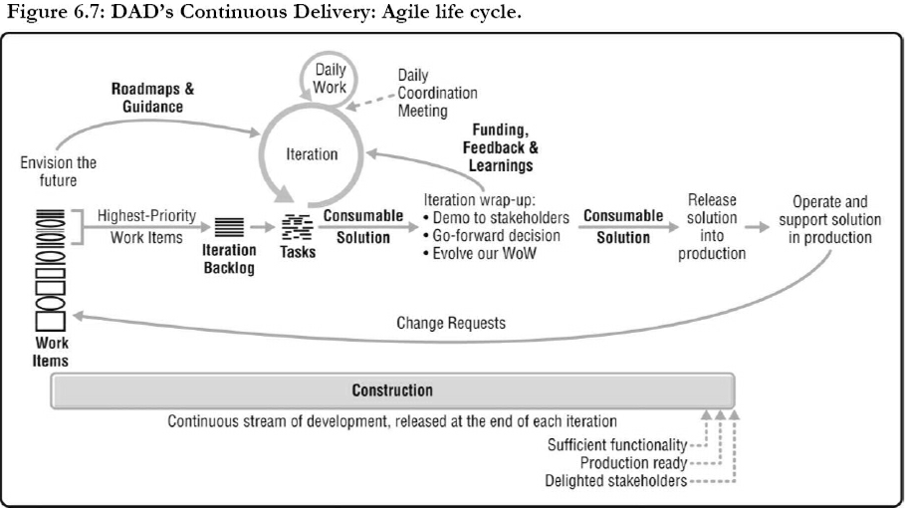
Continuous Delivery: Agile life cycle
© Ambler, Scott. Choose your WoW, Project Management Institute.

Slide 12
Continuous Delivery: Agile life cycle – Critical Aspects
There are several critical aspects to this life cycle:
Automation and technical practices are key. Teams require a mature set of technical practices around automated regression testing, continuous integration (CI), and continuous deployment (CD).
Inception occurred in the past. When the team was first initiated, Inception would have occurred and it may have occurred again when significant change occurred. But it seen as an activity, not a phase, hence Inception isn't depicted.
Transition has become an activity. Through automation of testing and deployment, the Transition phase has evolved from a multiday or multiweek effort to a fully automated activity that takes minutes or hours.
Explicit milestones and incoming workflows. There are still common, risk-based milestones to support consistent governance but some milestones are no longer appropriate as they would have been addressed in the past. Incoming workflows from other parts of the organization are shown, just as with the Agile and Lean life cycles.
© Ambler, Scott. Choose your WoW, Project Management Institute.
Notes:
There are several critical aspects to this life cycle:
Automation and technical practices are key. Teams require a mature set of technical practices around automated regression testing, continuous integration (CI), and continuous deployment (CD). To support these practices, investment in tools and paying down technical debt, and in particular writing the automated regression tests that are missing, needs to occur.
Inception occurred in the past. When the team was first initiated, Inception would have occurred and it may have occurred again when significant change occurred such as a major shift in business direction or technical direction. So, if such as shift occurs again then yes, you should definitely invest sufficient effort to reorient the team—we see this as an activity, not a phase, hence Inception isn't depicted. Having said this, we do see teams stop every few months and explicitly invest several days to negotiate, at a high level, what they will do for the next few months. This is something that SAFe calls big room planning and Agile Modeling calls an agile modeling session. These techniques are discussed in the Coordinate Activities process goal (Chapter 23).
Transition has become an activity. Through automation of testing and deployment, the Transition phase has evolved from a multiday or multiweek effort to a fully automated activity that takes minutes or hours.
Explicit milestones and incoming workflows. There are still common, risk-based milestones to support consistent governance. Some milestones are no longer appropriate, in particular Stakeholder Vision and Proven Architecture would have been addressed in the past (although if major changes occur there's no reason why you couldn't address these milestones again). Incoming workflows from other parts of the organization are shown, just as with the Agile and Lean life cycles.

Slide 13
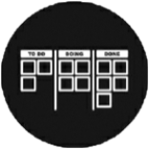
Lean Life Cycle
DAD's Lean life cycle, shown in Figure 6.8, promotes lean principles, such as minimizing work in process, maximizing flow, a continuous streaming of work (instead of fixed iterations), and reducing bottlenecks.
This project-oriented life cycle is often adopted by teams who are new to agile/lean who face rapidly changing stakeholder needs, a common issue for teams evolving (sustaining) an existing legacy solution, and by traditional teams that don't want to take on the risk of the cultural and process disruption usually caused by agile adoption (at least not right away).
© Ambler, Scott. Choose your WoW, Project Management Institute.

Slide 14
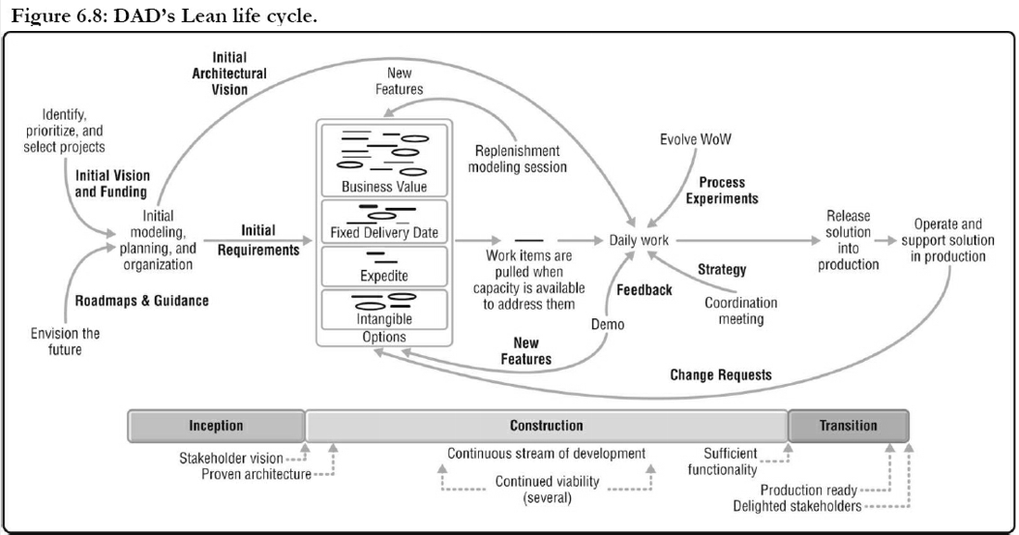
Lean Life Cycle
© Ambler, Scott. Choose your WoW, Project Management Institute.

Slide 15
Lean Life Cycle
There are several critical aspects to this life cycle:
Teams address work items one at a time. A major difference between the Lean and Agile life cycles is the lack of iterations. New work is pulled from the work item pool one item at a time as the team has capacity, as opposed to the iteration-based approach where it is pulled into the team in small batches.
Work items are prioritized just in time (JIT). Work items are maintained as a small options pool, often organized into categories by prioritization time, value or a fixed delivery date. The team chooses the most important work item at the time when they pull it in to be worked on.
Practices are performed when needed, as needed. As with work prioritization, other practices such as planning, holding demos, replenishing the work item pool, holding coordination meetings, making go-forward decisions, look-ahead modeling, and many others are performed on a JIT basis. This tends to remove some of the overhead that teams experience with the Agile life cycle, but requires more discipline to decide when to perform the various practices.
Teams actively manage their workflow. Lean teams use a Kanban board to manage their work with each column on the board representing a state. Work is depicted in the form of tickets, with a ticket being a work item from the options pool/backlog or a subtask of a work item. Tickets pass through each column (or state) with work-in-progress (WIP) limits in place.
Explicit phases, milestones, and incoming workflows. There is still an Inception phase and a Transition phase as well risk-based milestones to support consistent governance. Incoming workflows from other parts of the organization are shown (like Agile).
© Ambler, Scott. Choose your WoW, Project Management Institute.
Notes:
There are several critical aspects to this life cycle:
Teams address work items one at a time. A major difference between the Lean and Agile life cycles is the lack of iterations. New work is pulled from the work item pool one item at a time as the team has capacity, as opposed to the iteration-based approach where it is pulled into the team in small batches.
Work items are prioritized just in time (JIT). Work items are maintained as a small options pool, often organized into categories by prioritization time—some work items are prioritized by value (and hopefully risk) or a fixed delivery date, some must be expedited (often a severity 1 production problem or request from an important stakeholder), and some work is intangible (such as paying down technical debt or going on training). Prioritization is effectively performed on a JIT basis, with the team choosing the most important work item at the time when they pull it in to be worked on.
Practices are performed when needed, as needed. As with work prioritization, other practices such as planning, holding demos, replenishing the work item pool, holding coordination meetings, making go-forward decisions, look-ahead modeling, and many others are performed on a JIT basis. This tends to remove some of the overhead that teams experience with the Agile life cycle, but requires more discipline to decide when to perform the various practices.
Teams actively manage their workflow. Lean teams use a Kanban board [W] to manage their work. A Kanban board depicts the team's high-level process in terms of state, with each column on the board representing a state such as Needs a Volunteer, Being Explored, Waiting for Dev, Being Built, Waiting for Test, Being Tested, and Done. Those were just examples, because as teams choose their WoW, every team will develop a board that reflects their WoW. Kanban boards are often implemented on whiteboards or via agile management software. Work is depicted in the form of tickets (stickies on the whiteboard), with a ticket being a work item from the options pool/backlog or a subtask of a work item. Each column has a work-in-progress (WIP) limit that puts an upper limit on the number of tickets that may be in that state. As the team performs their work, they pull the corresponding tickets through the process on their Kanban board so as to coordinate their work.
Explicit phases, milestones, and incoming workflows. There is still an Inception phase and a Transition phase as well risk-based milestones to support consistent governance. Incoming workflows from other parts of the organization are shown, just as with the Agile life cycle.
Ambler, Scott. Choose your WoW. Project Management Institute

Slide 16
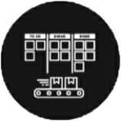
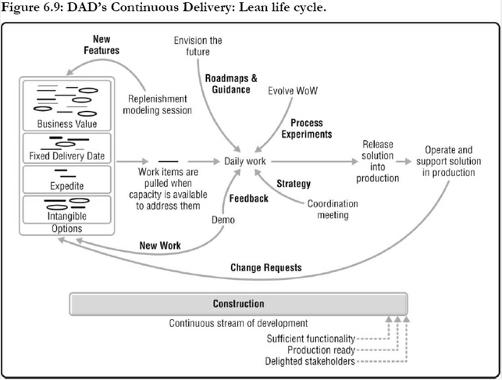
Continuous Delivery: Lean life cycle
DAD's Continuous Delivery: Lean life cycle, shown in Figure 6.9, is a natural progression from the Lean life cycle. Teams typically evolve into this life cycle from either the Lean life cycle or the Continuous Delivery: Agile life cycle.
Outcomes Lead to Continuous Exploration
Capturing work items as outcomes tends to evolve this life cycle into continuous exploration of stakeholder needs rather than the continuous order taking that we see with requirements-driven strategies.
© Ambler, Scott. Choose your WoW, Project Management Institute.
Notes:
There are several critical aspects to this life cycle:
Delivery of new functionality is truly continuous. Changes to production are delivered several times a day by the team, although the functionality may not be turned on until it is needed
Automation and technical practices are key. This is similar to the Continuous Delivery: Agile life cycle.
Inception and Transition have disappeared from the diagram. This occurred for the same reasons they disappeared for Continuous Delivery: Agile.
Explicit milestones and incoming workflows. Once again, similar to the Continuous Delivery: Agile life cycle. Outcomes Lead to Continuous Exploration An interesting thing that we've observed is that when you capture work items as outcomes, instead of as requirements such as user stories, this life cycle tends to evolve into continuous exploration of stakeholder needs rather than the continuous order taking that we see with requirements-driven strategies.
Ambler, Scott. Choose your WoW. Project Management Institute.

Slide 17
Continuous Delivery: Lean life cycle – Critical Aspects
There are several critical aspects to this life cycle:
Delivery of new functionality is truly continuous. Changes to production are delivered several times a day by the team, although the functionality may not be turned on until it is needed (this is a DevOps strategy called feature toggles described in Chapter 19).
Automation and technical practices are key. This is similar to the Continuous Delivery: Agile life cycle.
Inception and Transition have disappeared from the diagram. This occurred for the same reasons they disappeared for Continuous Delivery: Agile.
Explicit milestones and incoming workflows. Once again, similar to the Continuous Delivery: Agile life cycle
© Ambler, Scott. Choose your WoW, Project Management Institute.
Notes:
Ambler, Scott. Choose your WoW. Project Management Institute.

Slide 18
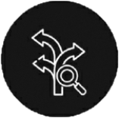
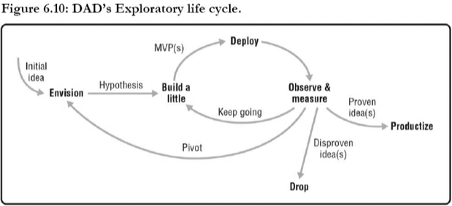
Exploratory Life cycle
DAD's Exploratory life cycle, shown in Figure 6.10, is based on the Lean Startup principles advocated by Eric Ries. The philosophy of Lean Startup is to minimize up-front investments in developing new products/services (offerings) in the marketplace in favour of small experiments [Ries]. The idea is to run some experiments with potential customers to identify what they want based on actual usage, thereby increasing our chance of producing something they're actually interested in. This approach of running customer-facing experiments to explore user needs is an important design thinking strategy for exploring “wicked problems” in your domain.
© Ambler, Scott. Choose your WoW, Project Management Institute.

Slide 19
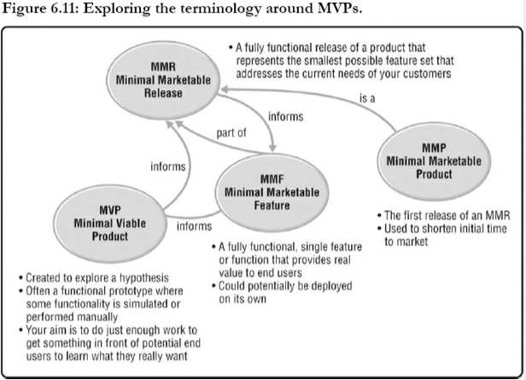
Exploratory Life cycle – Critical Aspects
There are several critical aspects to this life cycle:
This is a simplified scientific method. We come up with a hypothesis of what our customers want, we develop one or more minimal viable products (MVPs) which are deployed to a subset of potential customers, then we observe and measure how they work with the MVP(s). Based on the data we collect, we decide how we will go forward. Do we pivot and rethink our hypothesis? Do we rework one or more MVPs to run new experiments based on our improved understanding of customer needs? Do we discard one or more ideas? Do we move forward with one or more ideas and “productize them” into real customer offerings?
MVPs are prototypes (at best). The MVPs we create are built hastily, often “smoke and mirrors” or prototype-quality code, of which the sole purpose is to test out a hypothesis. It is not the “real thing,” nor is it meant to be. It's a piece of functionality or service offering that we get out in front of our potential customers to see how they react to it. See Figure 6.11 for an overview of MVPs and related concepts.
© Ambler, Scott. Choose your WoW, Project Management Institute.

Slide 20
Exploratory Life cycle – Critical Aspects
Run several experiments in parallel. Ideally, this life cycle entails running several experiments in parallel to explore our hypothesis. This is an improvement over Lean Startup, which focuses on a single experiment at a time—although it is easier to run a single experiment at a time, it takes longer to get to a good idea and, worse yet, runs the risk of identifying a strategy before other options have been considered.
Failed experiments are still successes. Some organizations are reluctant to run experiments because they are scared of failing, which is unfortunate because an exploratory approach such as this actually reduces your risk of product failure (which tend to be large, expensive, and embarrassing). Our advice is to make it “safe to fail,” to recognize that when an experiment has a negative result that this is actually a success because you have inexpensively learned what won't work, enabling you to refocus on looking for something that will.
Follow another life cycle to build the real product. Once we've discovered one or more ideas that it appears will succeed in the market, we now need to build the “real solution.” We do this by following one of the other DAD life cycles.
© Ambler, Scott. Choose your WoW, Project Management Institute.

Slide 21
Exploratory Tailorings
We've seen several different flavors, or perhaps several different tailorings is a better way of looking at it, over the years:
Exploration of a new offering. The most compelling reason, at least for us, is to apply this life cycle to explore an idea that your organization has for a new product.
Exploration of a new feature. At a smaller scale, the Exploratory life cycle is effectively the strategy for running an A/B test or split test where you implement several versions of a new feature and run them in parallel to determine which one is most effective.
Parallel proof of concepts (PoCs). With a PoC, you install and then evaluate a package, sometimes called a commercial off-the-shelf solution (COTS), within your environment. An effective way to decrease the risk of software acquisition is to run several PoCs in parallel, one for each potential software package that you are considering, and then compare the results to identify the best option available. This is often referred to as a “bake-off.”
Strategy comparisons. Some organizations, particularly ones in very competitive environments, will start up several teams initially to work on a product. Each team basically works through Inception, and perhaps even a bit of Construction, the aim being to identify a vision for the product and prove out their architectural strategy. In this case, their work is more advanced than an MVP but less advanced than an MMR. Then, after a period of time, they compare the work of the teams and pick the best approach—the “winning team” gets to move forward and become the product team.
© Ambler, Scott. Choose your WoW, Project Management Institute.

Slide 22
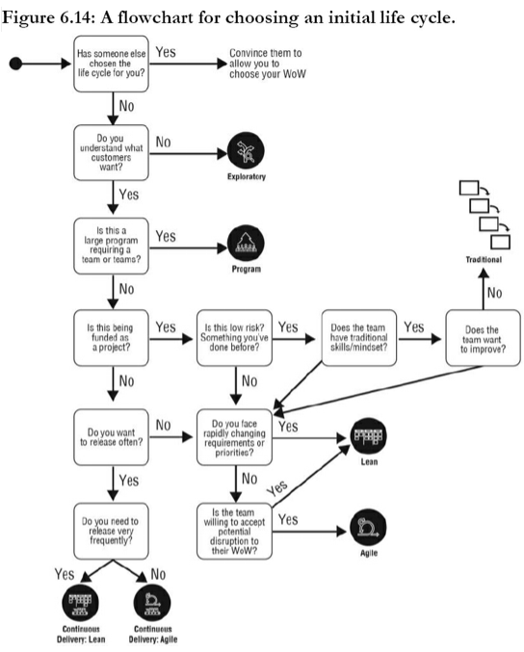
When Should You Adopt Each Life Cycle?
Every team should choose its own life cycle, but how do you do this?
It's tempting to have your portfolio management team make this choice—well, at least it is for them. At best, they should make a (hopefully solid) suggestion when they first initiate an endeavour.
But in the end the choice of life cycle should be made by the team if you want to be effective. This can be a challenging choice, particularly for teams new to agile and lean.
An important part of the process-decision scaffolding provided by DAD is advice for choosing a life cycle, including the flowchart of Figure 6.14.
© Ambler, Scott. Choose your WoW, Project Management Institute.

Slide 23
Constraining factors when choosing a delivery life cycle
Team skills. The two continuous delivery (CD) life cycles require the team to have a lot of skill and discipline. The other DAD life cycles also require skill and discipline, although the two CD life cycles stand out. With the traditional life cycle, you can get away with lower skilled people people—due to the handoff-oriented nature of traditional, you can staff each phase with narrowly skilled specialists. Having said that, we have seen many traditional teams with very skilled people on them.
Team and organization culture. The Agile and Continuous Delivery life cycles require flexibility within the team and within the parts of the organization that the team interacts with. Lean strategies can be applied in organizations with a varying range of flexibility. Traditional can, and often is, applied in very rigid situations.
The nature of the problem. The Continuous Delivery life cycles work very well when you can build and release in very small increments. The other DAD life cycles work very well in small increments. Traditional is really geared for big releases.
Business constraints. The key issue here is stakeholder availability and willingness, although financial/funding flexibility is also critical. The Exploratory life cycle requires a flexible, customer-oriented, and experimental mindset on the part of stakeholders. Agile, because it tends to release functionality in terms of complete features, also requires flexibility in the way that we interact with stakeholders. Surprisingly, the Continuous Delivery life cycles require less stakeholder flexibility due to being able to release functionality that is turned off, thereby providing greater control over when something is released (by simply toggling it on).
© Ambler, Scott. Choose your WoW, Project Management Institute.
Notes:
Team skills. The two continuous delivery (CD) life cycles require the team to have a lot of skill and discipline. The other DAD life cycles also require skill and discipline, although the two CD life cycles stand out. With the traditional life cycle, you can get away with lower skilled people people—due to the handoff-oriented nature of traditional, you can staff each phase with narrowly skilled specialists. Having said that, we have seen many traditional teams with very skilled people on them.
Team and organization culture. The Agile and Continuous Delivery life cycles require flexibility within the team and within the parts of the organization that the team interacts with. Lean strategies can be applied in organizations with a varying range of flexibility. Traditional can, and often is, applied in very rigid situations.
The nature of the problem. The Continuous Delivery life cycles work very well when you can build and release in very small increments. The other DAD life cycles work very well in small increments. Traditional is really geared for big releases.
Business constraints. The key issue here is stakeholder availability and willingness, although financial/funding flexibility is also critical. The Exploratory life cycle requires a flexible, customer-oriented, and experimental mindset on the part of stakeholders. Agile, because it tends to release functionality in terms of complete features, also requires flexibility in the way that we interact with stakeholders. Surprisingly, the Continuous Delivery life cycles require less stakeholder flexibility due to being able to release functionality that is turned off, thereby providing greater control over when something is released (by simply toggling it on).

Slide 24
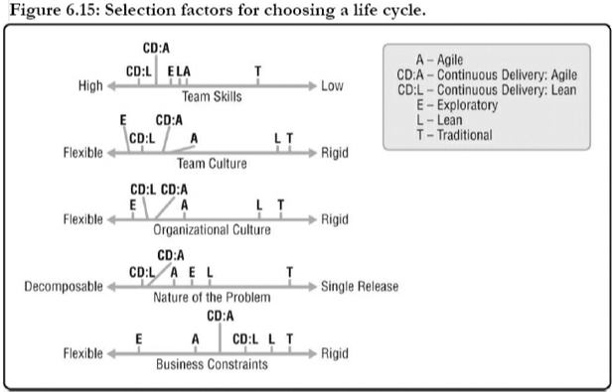
Constraining factors when choosing a delivery life cycle
© Ambler, Scott. Choose your WoW, Project Management Institute.

Slide 25
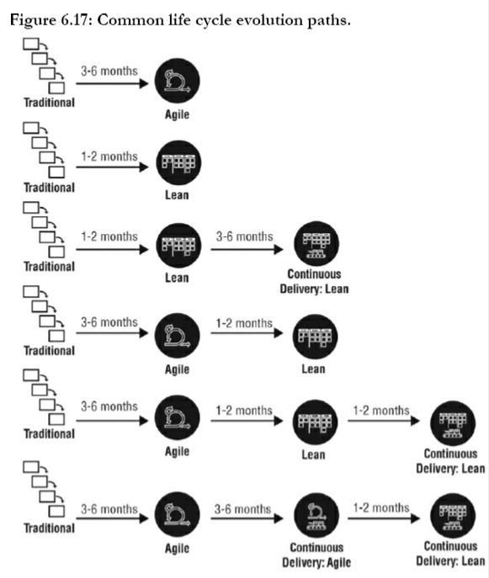
Life Cycles Are Just Starting Points
DAD teams will often evolve from one life cycle to another. This is because DAD teams are always striving to Optimize Flow, to improve their WoW as they learn through their experiences and through purposeful experimentation.
Figure 6.17 shows common evolution paths that we've seen teams go through. The times indicated in Figure 6.17 reflect our experiences when teams are supported by Disciplined Agile (DA) training and Certified Disciplined Agile Coaches (CDACs)—without this, expect longer times and most likely higher total costs, on average.
When helping a traditional team move to a more effective WoW, a common approach is to start with the Agile life cycle. This is a “sink or swim” approach that experience shows can be very effective, but it can prove difficult in cultures that resist change.
A second path shown in this diagram is to start traditional teams with a Lean Kanban [Anderson] approach wherein the team starts with their existing WoW and evolves it over time via small changes into the Lean life cycle. While this is less disruptive, it can result in a much slower rate of improvement since the teams often continue to work in a silo fashion with Kanban board columns depicting traditional specialties.
© Ambler, Scott. Choose your WoW, Project Management Institute.

Slide 26
Thank You

